Slide 1
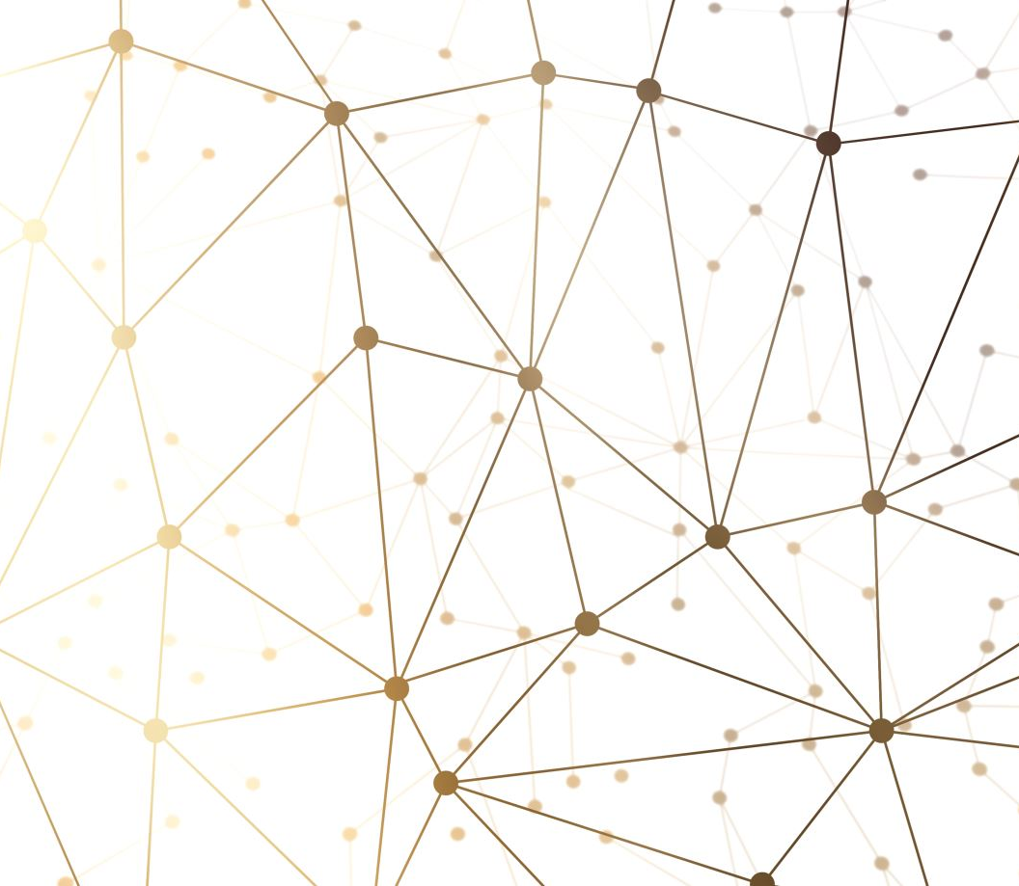
Tablet Recognition system using CNN

Slide 2

Vivek Yadav Baira Sachin Beniwal Sai Krishna

Slide 3
Responsibilities & Contribution
Vivek: Problem Methodology, Tablets Data, PPT
Sachin: Related Work, Project Documentation
Sai Krishna: Tablet Images, Proposed Solution, References

Slide 4

Motivation
A major obstacle to the adoption and efficient use of technology, particularly tablets, which have enormous promise for education, communication, and empowerment, is illiteracy in many communities throughout the world.
This research introduces a revolutionary TRS specifically designed to meet the demands of illiterate people, allowing them to independently and intuitively engage with tablet devices.

Slide 5
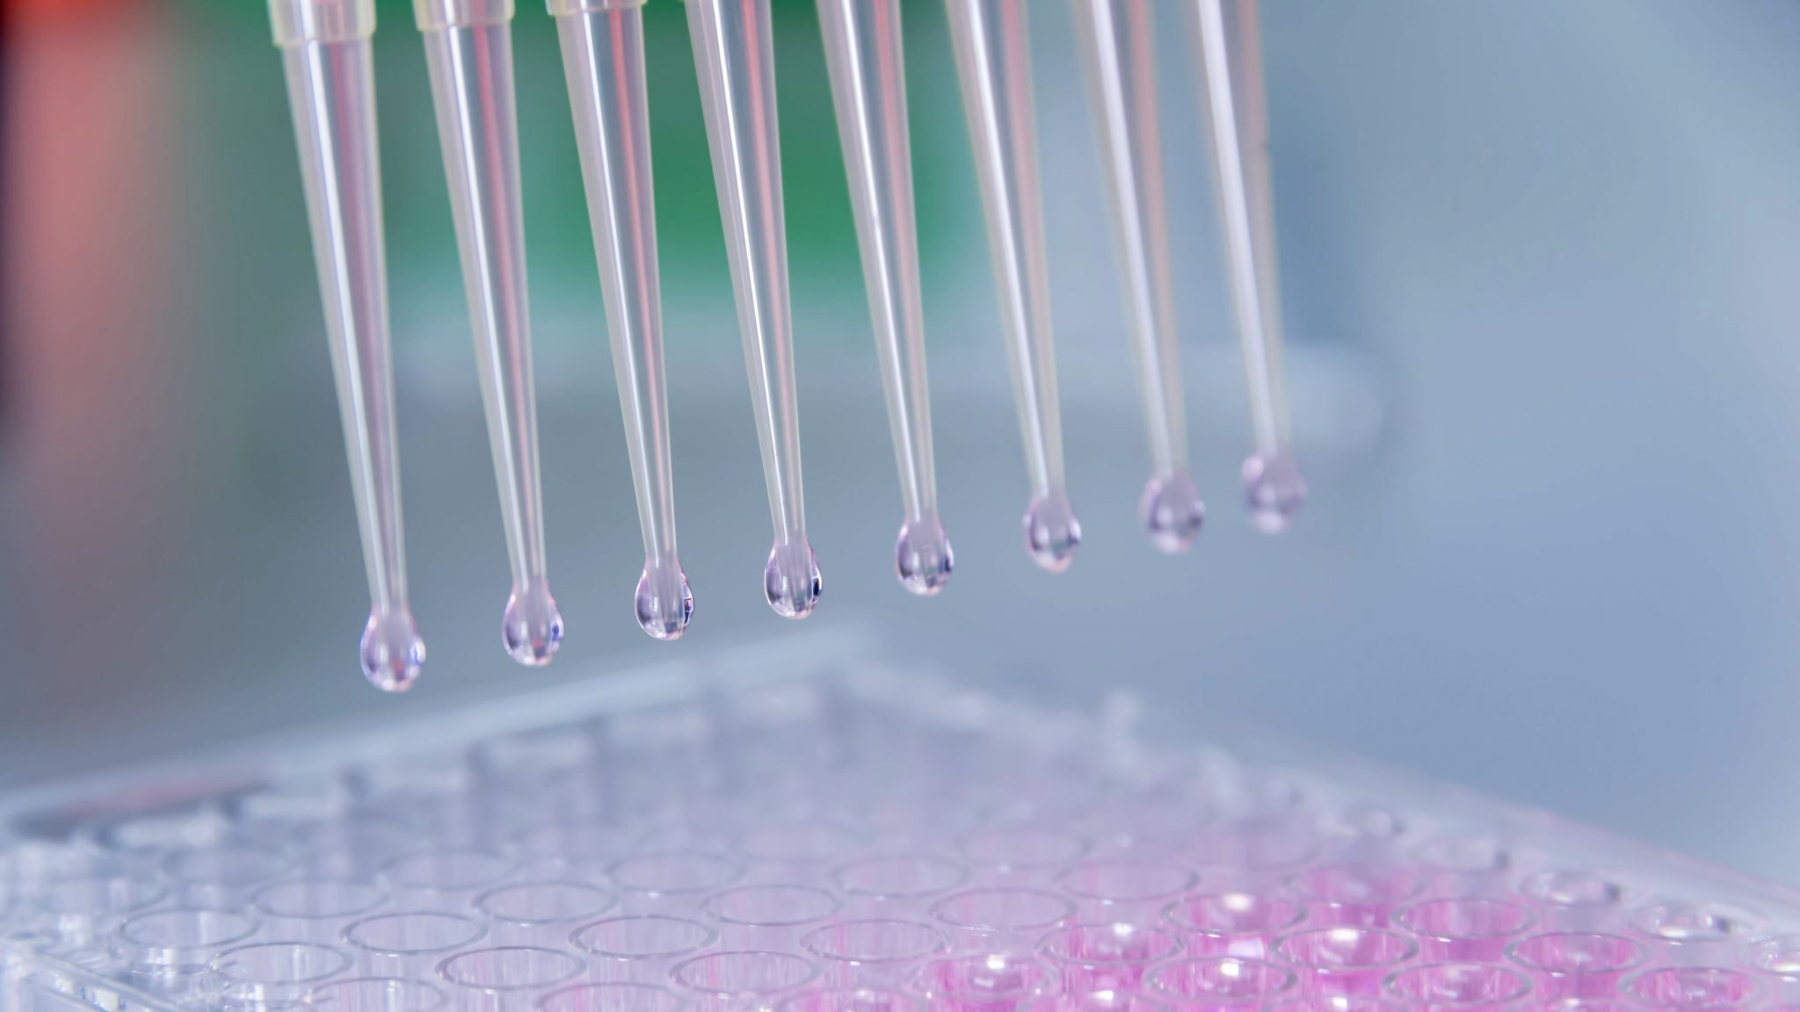
Objectives
The system's objective is to recognize tablets accurately and efficiently so that workflows may be optimized and human error can be minimized.
. In order to automate the tablet identification procedure, we present in this research a tablet recognition system built on convolutional neural networks (CNNs).

Slide 6
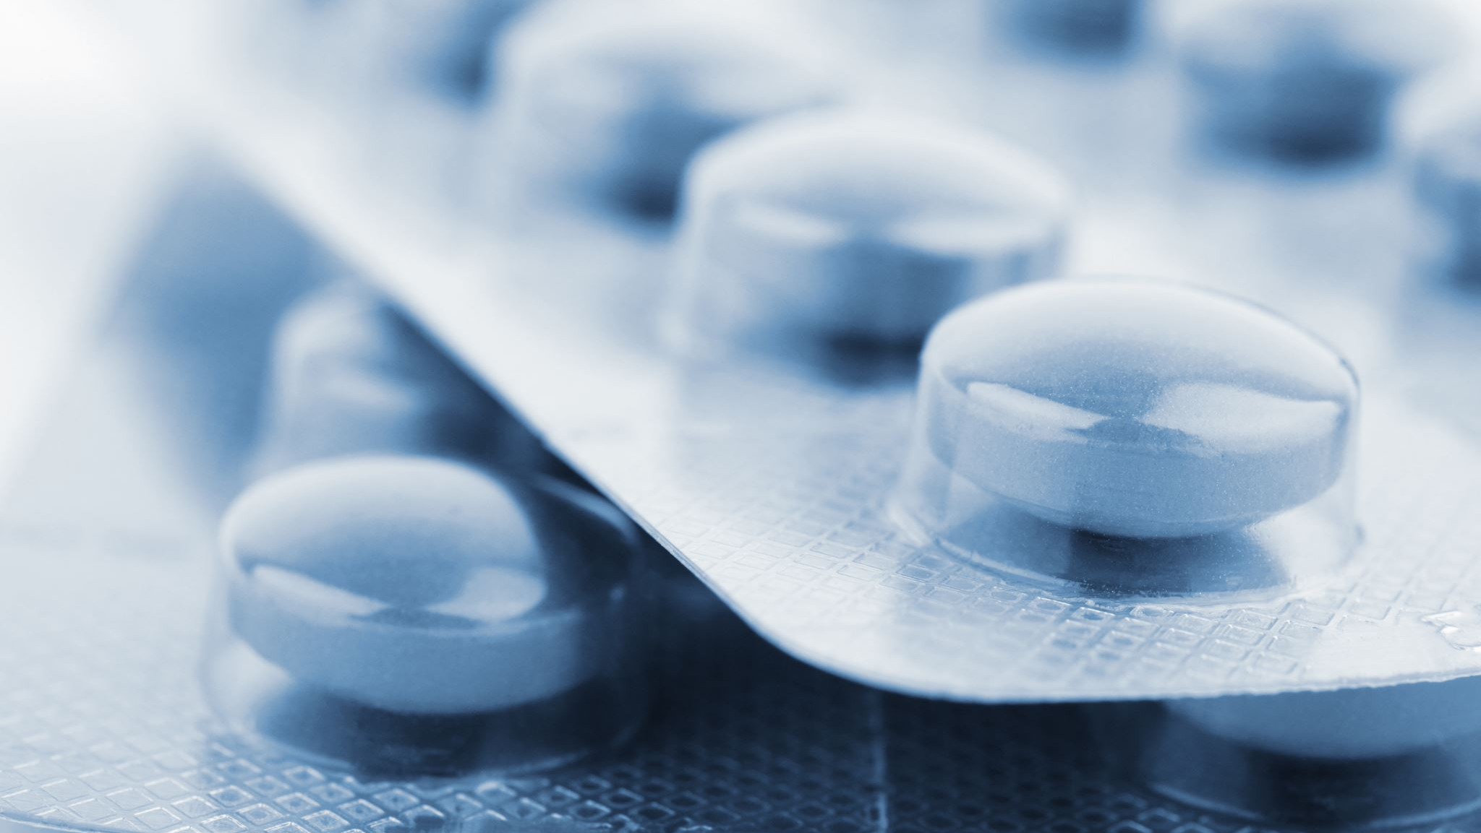
Related Work
1.A real-time medicine packet identification system for senior medication dispensing
2. Med Glasses: A Deep Learning-Based Wearable Smart Glasses Drug Pill Recognition System for Chronic Visually Impaired Patients
3.A three-phase method for identifying medication boxes.

Slide 7
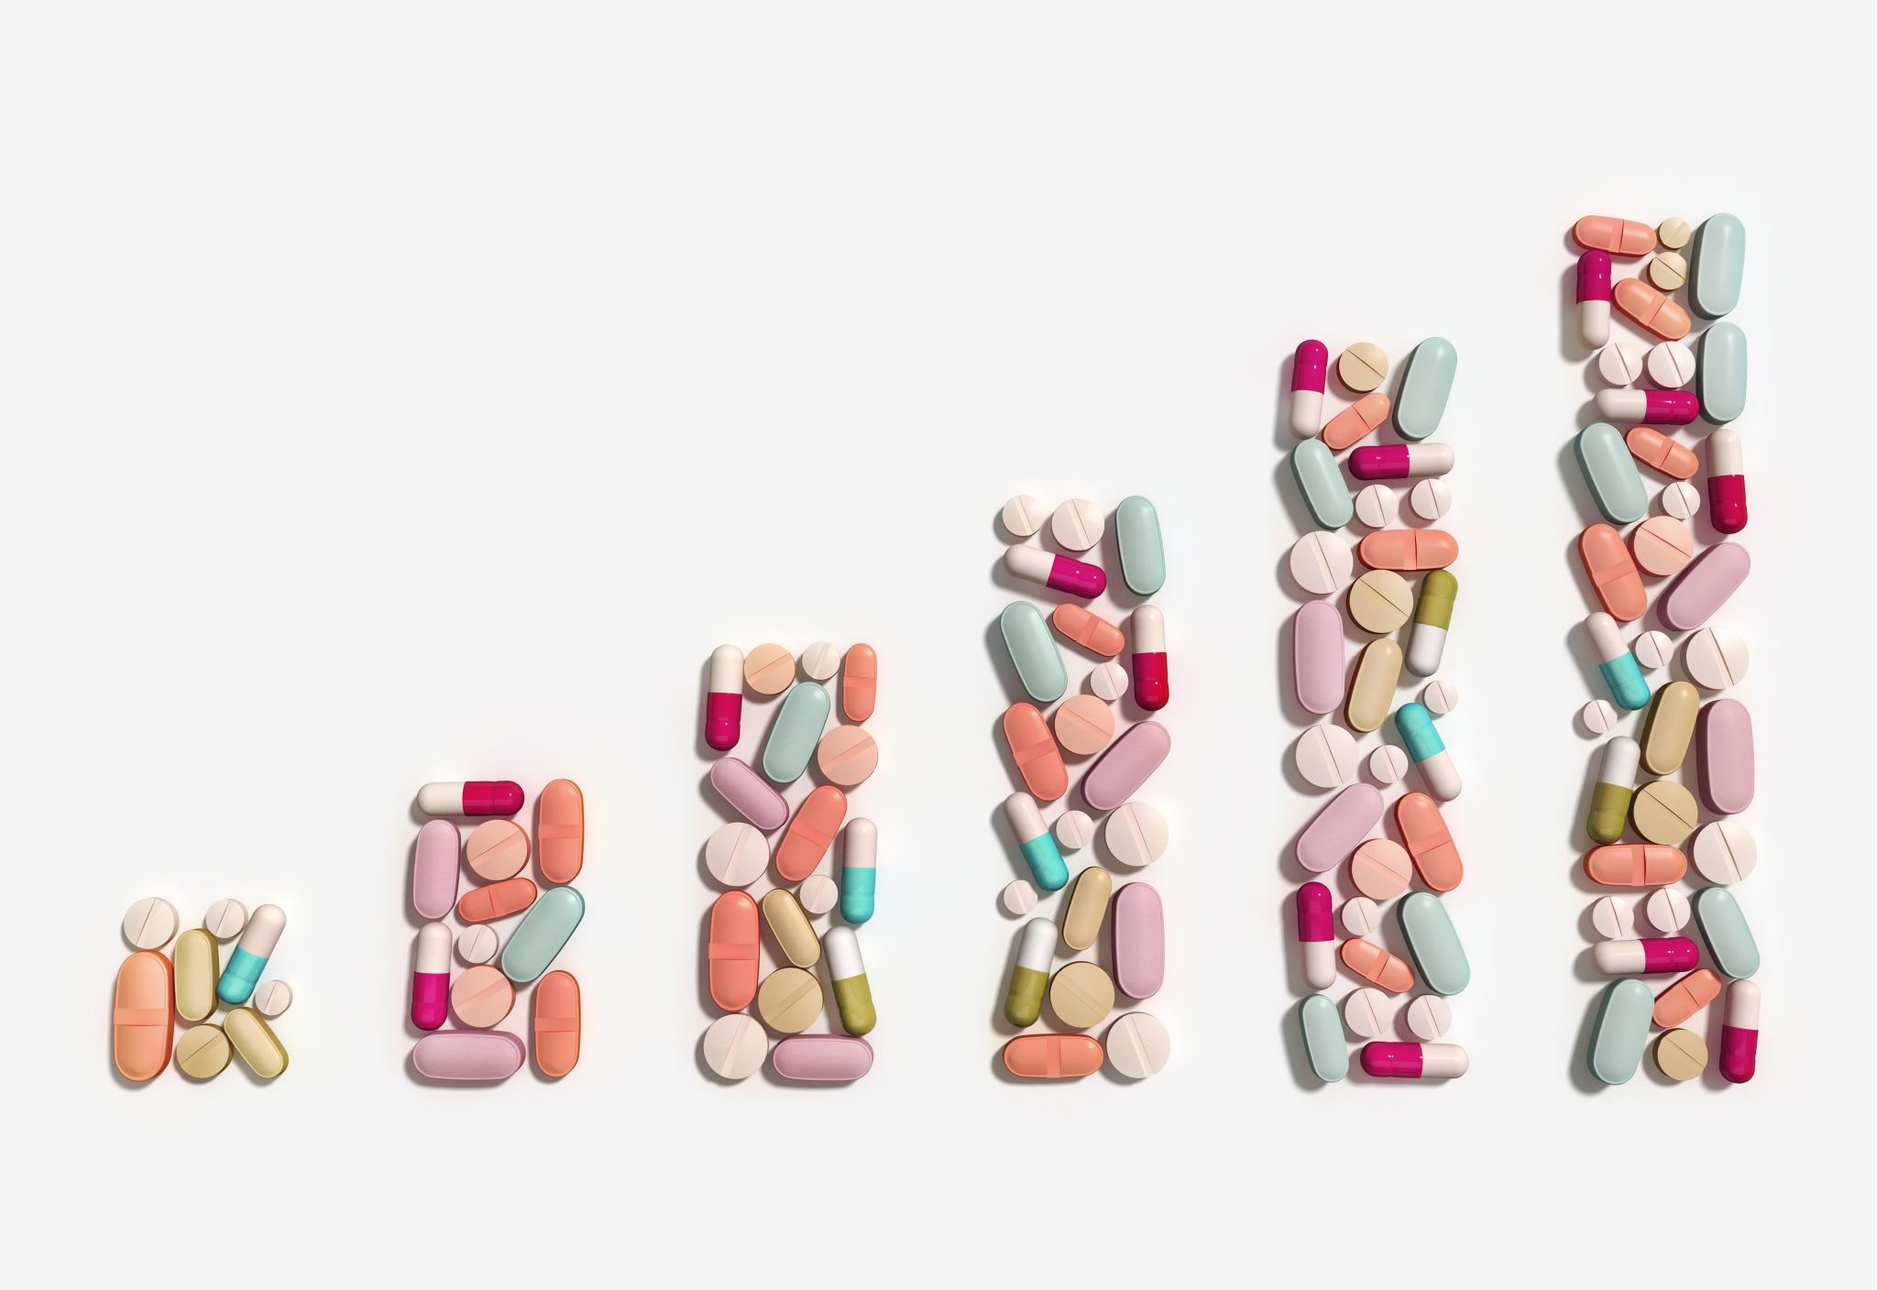
Problem Statement
Globally, almost 28% of individuals are 65 years of age or older
Medication provision requires a significant amount of labor and material resources due to the large number of inhabitants

Slide 8
Proposed Solution
This research proposes a pharmaceutical distribution system that provides users with tablets information upon uploading their image, hence eliminating the need for third-party monitoring operations
The several convolutional layers in the suggested CNN architecture for injury diagnosis are followed by pooling layers for spatial down sampling and non-linear activation functions to provide non-linearity to the model

Slide 9
Convolutional Layers
These layers are made up of many filters that convolve across the input picture to capture various scales of spatial characteristics.
Input Layer: The medical picture data is received by the input layer, usually as matrices that indicate the intensities of the pixels.
Activation Function (ReLU): Rectified Linear Unit (ReLU) activation functions facilitate the learning of complicated connections in the data by introducing non-linearity to the model by substituting zero for negative pixel values.

Slide 10
Pooling Layers: By combining data from specific areas of the input feature maps, pooling layers carry out spatial down sampling. In order to minimize computational complexity and preserve the most important properties, max pooling is frequently utilized.
Batch Normalization: By guaranteeing steady gradients across the network, batch normalization layers normalize the activations of every layer, minimizing internal covariate changes and speeding up the training process.
Fully Connected Layers: Using densely connected neurons, these layers combine features discovered by the convolutional layers to generate final predictions.

Slide 11
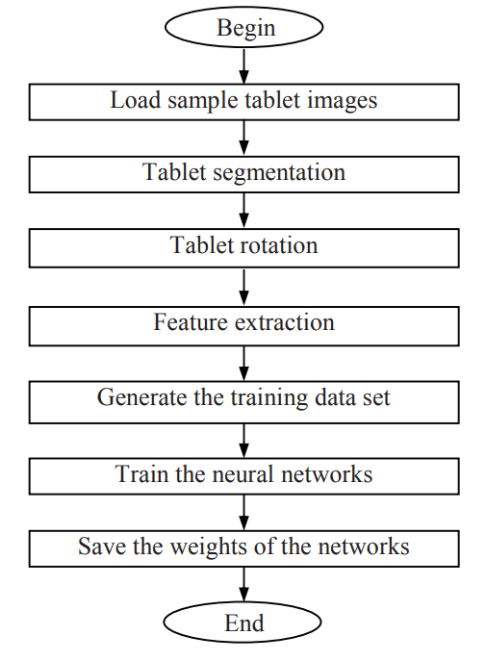
Proposed Methodology
Neural networks are trained on a set of tablet samples
Initially, the tablet backdrop of the imprinted sign in the tablet pictures is eliminated using a tablet segmentation technique.
The tablet pictures are then oriented and positioned in relation to the reference tablet. The neural network training method then makes use of the characteristics that were derived from the imprinted symbols.
In order to recognize fresh inputs from the user without requiring additional training, the weights of the learned neural networks are saved

Slide 12
Proposed Methodology
Importing Modules
Importing Data
Preprocessing Data
Defining Layers
Creating Checkpoints
Training and Testing the Model
Saving the Model
Loading the Model
Plotting the Results
Creating the Interface
Predicting Classes for new images

Slide 13
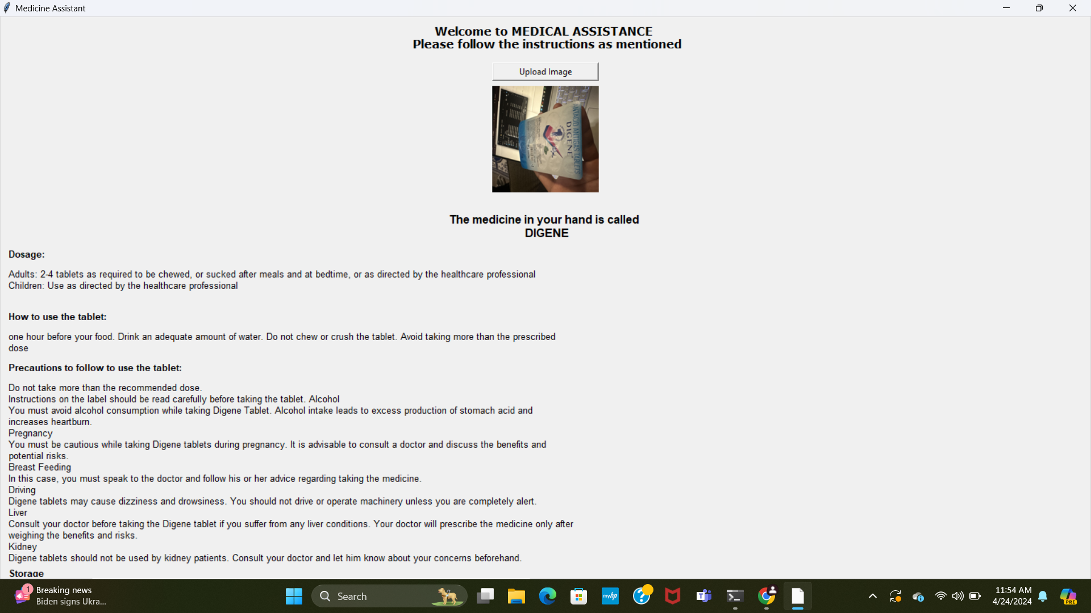
Results

Slide 14
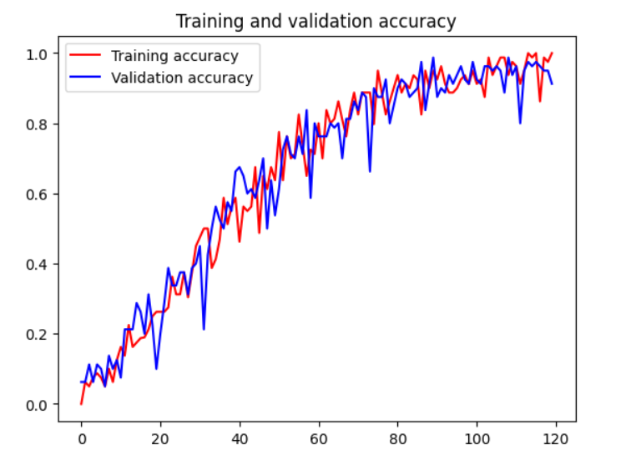
Results
The training and validation accuracy for TRS by the CNN model topped out at 95.3%.

Slide 15
Conclusion
The project on tablet recognition using Convolutional Neural Networks (CNN) has demonstrated promising results, showcasing the efficacy of deep learning in image classification tasks.
Through extensive training and validation, the CNN model has been able to accurately identify and classify tablets from images with a relatively high degree of precision.
This achievement not only highlights the potential of CNNs in pharmaceutical and healthcare industries for automated identification processes but also underscores their broader applicability in image recognition tasks across various domains.

Slide 16
References
Real-time medicine packet recognition system in dispensing medicines for the elderly by Xuebin Yue, Bing Lyu, Hengyi Li, Lin Meng, Katsuyuki Furumoto published in Measurement: Sensors 18 (2021) 100072
MedGlasses: A Wearable Smart-Glasses-Based Drug Pill Recognition System Using Deep Learning for Visually Impaired Chronic Patients by Wan-Jung Chang, Liang-Bi Chen, Chia-Hao Hsu, Jheng-Hao Chen, Tzu-Chin Yang, Cheng-Pei Lin published in IEEE
A three-staged approach to medicine box recognition by Luis Magalhães, Bruno Ribeiro, Nelson Alves, Miguel Guevara published in IEE

Slide 17
Thank You

